Slide 1
MOLLEGENERATOR.COM · PARTNER PROGRAM
YOUR OWN MOLLE PANEL SITE IN ONE DAY
A ready catalog, an online configurator and orders in your Telegram — under your name, with your materials. No development.
from $49
For laser-cutting shops · case makers · vehicle outfitters · gear stores
per year · no commission

Slide 2
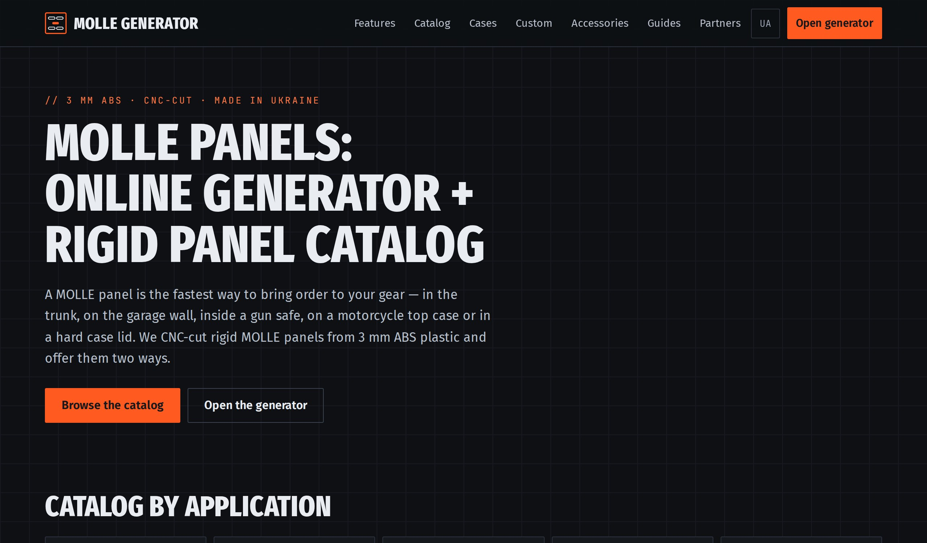
WHAT IS MOLLEGENERATOR.COM
A MOLLE PANEL PLATFORM THAT ALREADY WORKS
300+
60+
SEO pages UA / EN
case and vehicle models with dimensions
24
DXF
base panels + model-specific panels
a cut-ready file in a minute
The online generator: the customer sets the size, the number of cells, mounting holes (including MD173) and sees the price instantly. Catalog: vehicles, Pelican / Nanuk / SKB / MilitarycaseUA cases, safes, garage, medical.
mollegenerator.com — home page

Slide 3
WHY IT MATTERS
CUSTOMERS ASK FOR MOLLE — AND THERE IS NOTHING TO SELL
✕
No configurator
✕
No catalog
The customer wants a panel “for my trunk”. Without a tool it is messages, hand sketches and a manual drawing for every order.
Panels for specific cases and vehicles need measurements and a size database. Building one yourself takes months.
INSTEAD — A READY PLATFORM UNDER YOUR NAME.
✕
Development doesn’t pay off
✕
Pricing by hand
A site + configurator + DXF export + pricing is 2–4 months of developer work for a single product.
Every request is a manual estimate of area, cutting and coating. The customer waits, some leave.

Slide 4
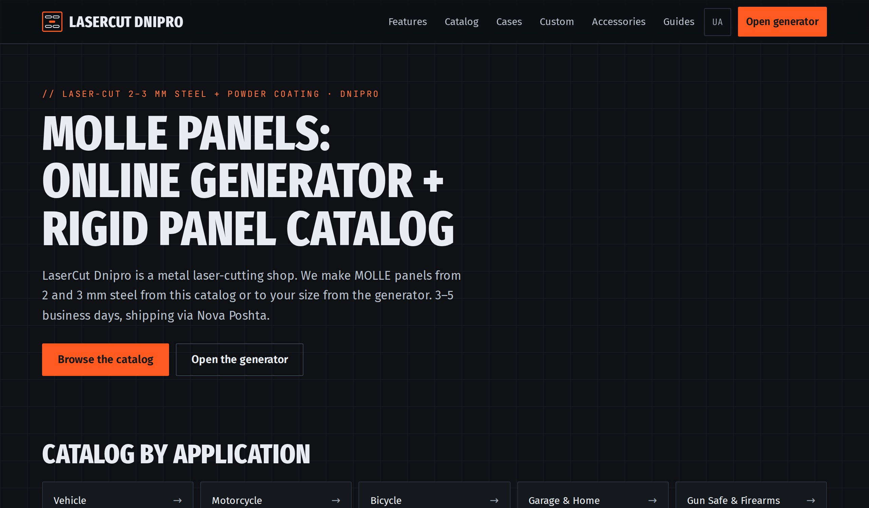
THE SOLUTION
NAME.MOLLEGENERATOR.COM — YOUR OWN SITE
Your name in the header and titles, your contacts in the footer, your intro on the home page
No mention of other makers — the site looks like yours
The full panel catalog and the generator — everything on the main site
Customers only see the materials you make
Orders from the “Order” button go straight to your Telegram
Technically: the same site, rewritten on the fly at the Cloudflare level. Your pages are hidden from search engines (except the home page) — you don’t compete with the main site in search.
Example: partner.mollegenerator.com — demo partner LaserCut Dnipro

Slide 5
HOW IT WORKS
FIVE STEPS FROM REQUEST TO SHIPMENT
01
02
03
04
05
Customer arrives
Picks a panel
Orders
You get it in Telegram
Production and shipping
›
›
›
›
At your sub-domain — from your ads, social media, business card or the main site.
A ready one from the catalog — or a custom size in the generator. Priced instantly.
Name, phone, city, quantity, comment. One screen.
Customer data, panel, material, total. Workshop — also a machine-ready DXF and the drawing.
Seller: we cut and ship. Workshop: the file is machine-ready — you cut it.
Panel designs are the platform’s base: 24 base panels + panels for specific case and vehicle models. Need one that isn’t there? Suggest it from the generator, we add it.

Slide 6
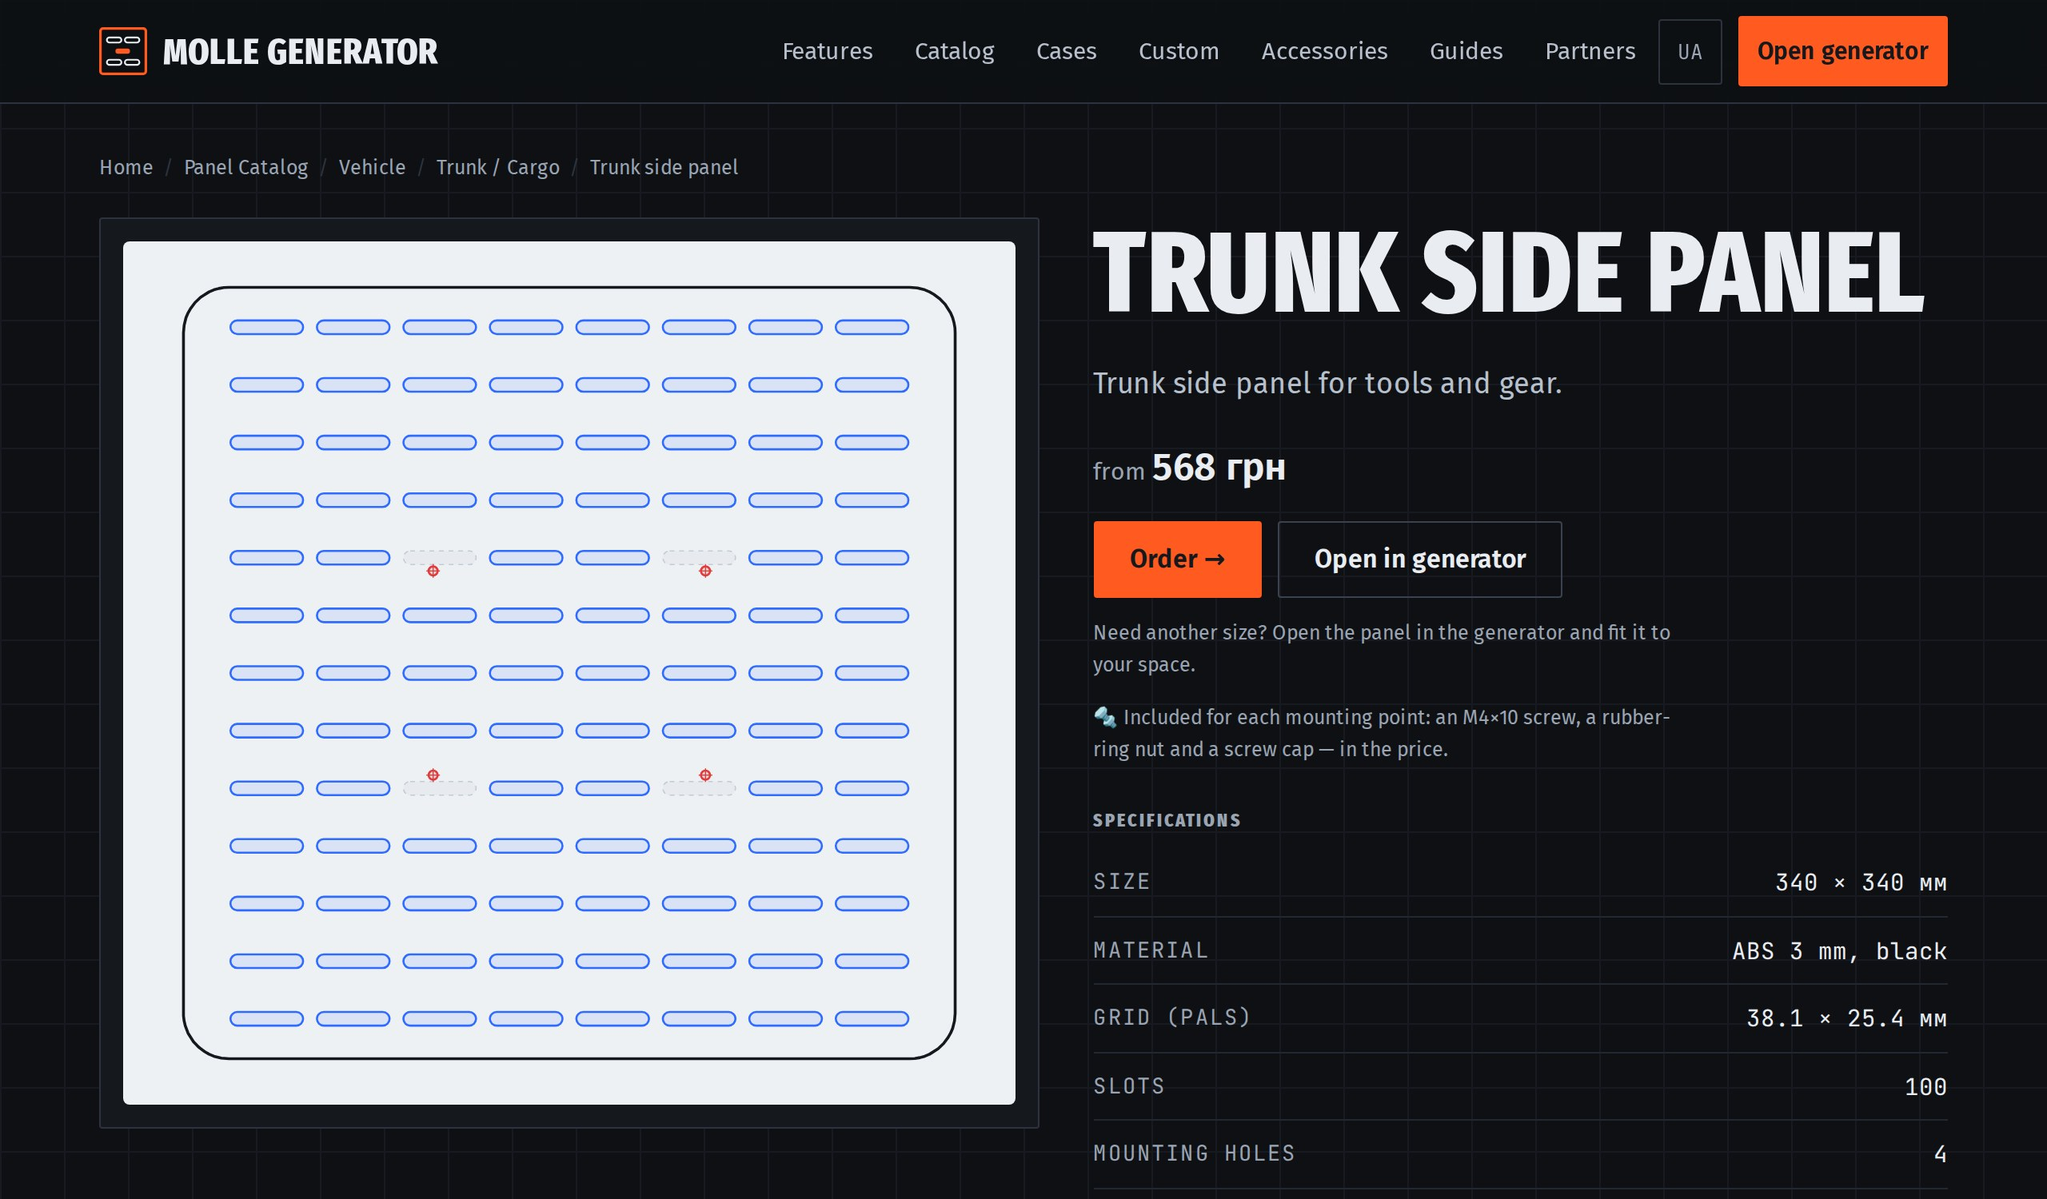
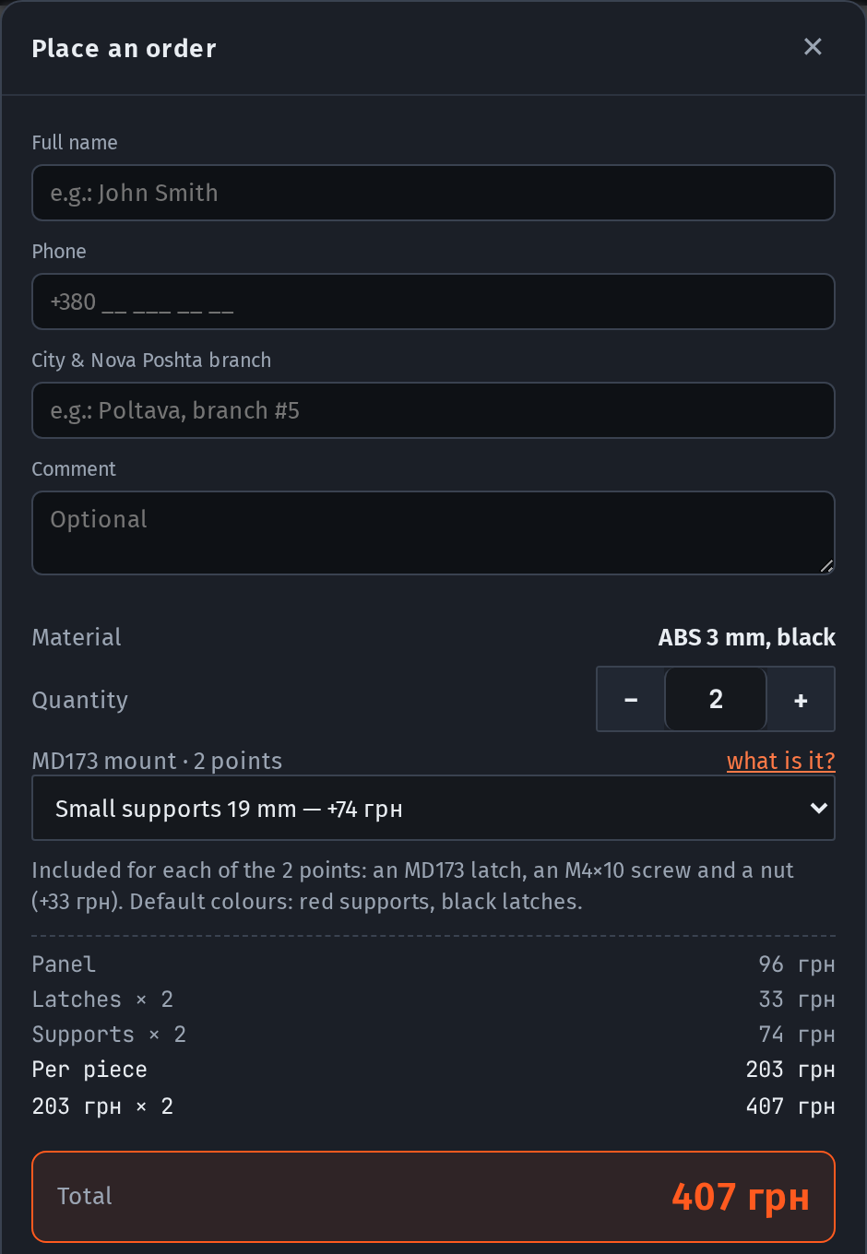
WHAT THE CUSTOMER SEES
PANEL, PRICE, ORDER — NO BACK-AND-FORTH
A colour-coded drawing: outline, slots, windows, holes
Specs, MD173 mounting, photos and video
Price for your material and quantity
Panel page
The mounting kit is added to the order automatically
Order form

Slide 7
WHAT THE PARTNER GETS
ORDERS, NOT DEVELOPMENT
✓
Orders in Telegram
✓
Only your products
✓
Your prices
Seller — the order data, we produce. Workshop — the full kit: DXF, drawing, spec.
Turn on what you make: 2 mm steel, 3 mm steel, aluminium, ABS, 3D printing.
Price comes from geometry; your multiplier stays within an agreed corridor.
✓
A design library
✓
Zero development
✓
Launch in a day
Panels for Pelican, Nanuk, MilitarycaseUA cases and vehicles — with verified sizes.
Site, configurator, DXF, pricing, analytics — already there, updated centrally.
Name, contacts, Telegram and a list of materials — and the sub-domain is live.

Slide 8
WHO IT IS FOR
WHO THE PARTNERSHIP FITS
01
Laser cutting
04
Gear stores
2–3 mm steel, powder coating, aluminium. Panels are a steady, repeatable product.
A panel is a reason to sell pouches. The customer picks a size, you sell the kit.
02
Case makers
05
3D printing
A lid panel as an upsell with every case. Your model may already be in the catalog.
Panel accessories: holders, clips, mounts. A separate product type in the catalog.
03
Vehicle outfitters, overlanding
06
Safe and top-case dealers
Panels for trunks, seat backs, doors. You install — the platform prices and draws.
MOLLE for a safe door or a motorcycle top case — ready designs for your models.

Slide 9
TERMS
SIMPLE: ONE YEARLY FEE, NO COMMISSION
Makers — paid per panel
No site needed: jobs in Telegram 1–2 times a week, a ready DXF, a fixed price, paid on shipment.
Your own catalog site
from $49
Case makers — free
Send us the product — we measure it, make test panels, take photos and send it back.
per year
Designers — paid
For accepted designs with a mounting guide and for 3D accessory models.
Seller — $49: a storefront with the catalog and generator, your prices, orders in your Telegram. Workshop — $199: + online payment through the platform and Generator Pro. No commission on orders.
Integrators — $400 + $30 / month
All models and guides, a profile on the map, dealer price −25–35%. No territories — the customer chooses.
Payment and contract
Site — public offer, production — subcontract after a test order, designs — an act per design.

Slide 10
START IN ONE DAY
FOUR THINGS TO LAUNCH YOUR SITE
1
Name and city
2
Contacts: phone, e-mail, Telegram
3
A Telegram chat for incoming orders
4
The list of materials you make
Partner site demo: partner.mollegenerator.com
Partner program: mollegenerator.com/partners/
Write to us — and tomorrow your site takes orders.

